Slide 1

Detecting Breast
Cancer
A project by :
Mini Yadav
Belinda Achuo
Elena Dragomir

Slide 2

Project Outline
Ellie
Project Proposal
Objectives
Data Preparation
Data Pre-processing
Building the Model
Randomized Search to find the best parameters (Logistic regression)
The Final Model (Logistic regression)
Predicting an observation - Live

Slide 3

Project proposal
Belinda
Breast cancer is the most common type of cancer in the UK. Most women diagnosed with breast cancer are over the age of 50, but younger women can also get breast cancer.
About 1 in 8 women are diagnosed with breast cancer during their lifetime. However, there's a good chance of recovery if it's detected at an early stage.
The early diagnosis of breast cancer can improve the prognosis and chance of survival significantly, as it can promote timely clinical treatment to patients. In addition, further accurate classification of benign tumours can prevent patients from undergoing unnecessary treatments.
Thus, the correct diagnosis of breast cancer and classification of patients into malignant or benign groups is the subject of much research.

Slide 4

Objectives
Belinda
Our project aims to observe which features are most helpful in predicting malignant or benign cancer and to see general trends that may aid us in model selection and hyperparameter selection.
Our goal is to determine whether breast cancer is benign or malignant. As such, we have used machine learning classification methods to fit a function that can predict the cancer type to achieve this.

Slide 5
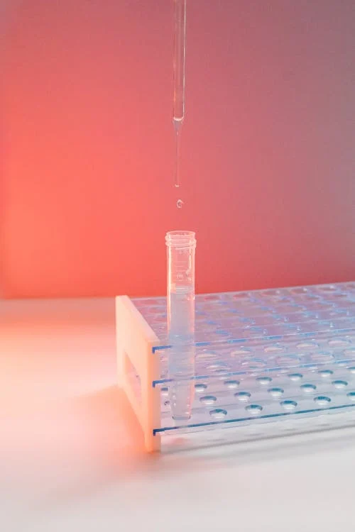
Data Preparation
Mini
The dataset we used for this project is publicly available on kaggle.com and was created by Dr William H. Wolberg, a physician at the University Of Wisconsin Hospital in Madison, Wisconsin, USA.
To create the dataset, Dr Wolberg used fluid samples taken from patients with solid breast masses and an easy-to-use graphical computer program called Xcyt, which can analyse cytological features based on a digital scan. The program uses a curve-fitting algorithm to compute ten features from each one of the cells in the sample, and then it calculates the mean value, extreme value and standard error of each feature for the image, returning a 30 real-valued vector.

Slide 6
Data Preparation
Mini
Attribute Information:
ID number
Diagnosis (M = malignant, B = benign)
Ten real-valued features are computed for each cell nucleus:
radius (mean of distances from center to points on the perimeter)
texture (standard deviation of gray-scale values)
perimeter
area
smoothness (local variation in radius lengths)
compactness (perimeter² / area — 1.0)
concavity (severity of concave portions of the contour)
concave points (number of concave portions of the contour)
symmetry
fractal dimension (“coastline approximation” — 1)
The mean, standard error and “worst” or largest (mean of the three largest values) of these features were computed for each image, resulting in 30 features.

Slide 7
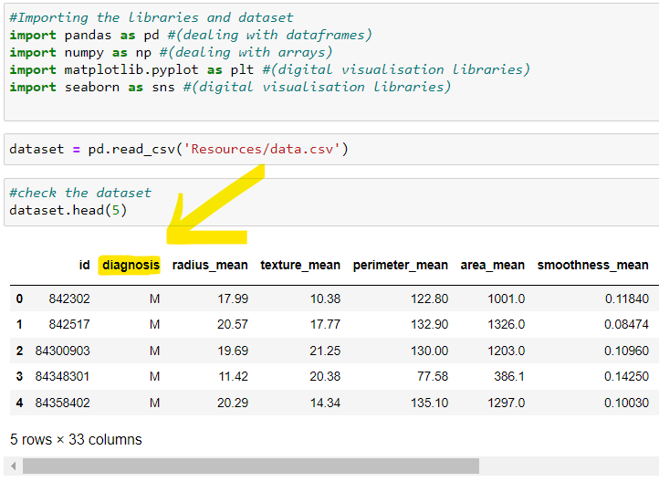
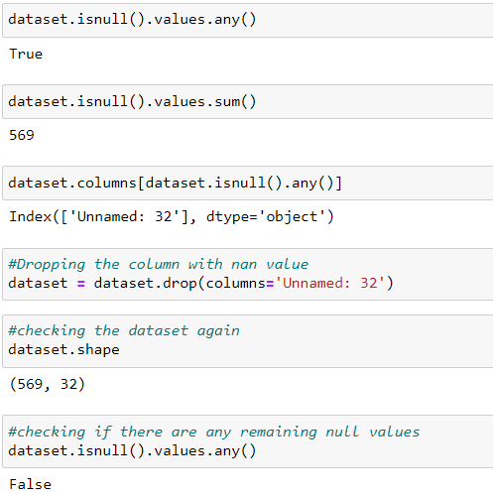
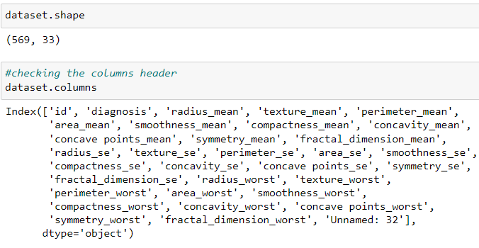
Data Pre-processing - Data exploration
Belinda
Breast Cancer Wisconsin (Diagnostic) Data Set is available on https://www.kaggle.com/uciml/breast-cancer-wisconsin-data
First we imported the libraries, read the csv file and checked the dataset.
We explored the data to get insights about the data.
We then checked if there are missing values in the dataset.

Slide 8
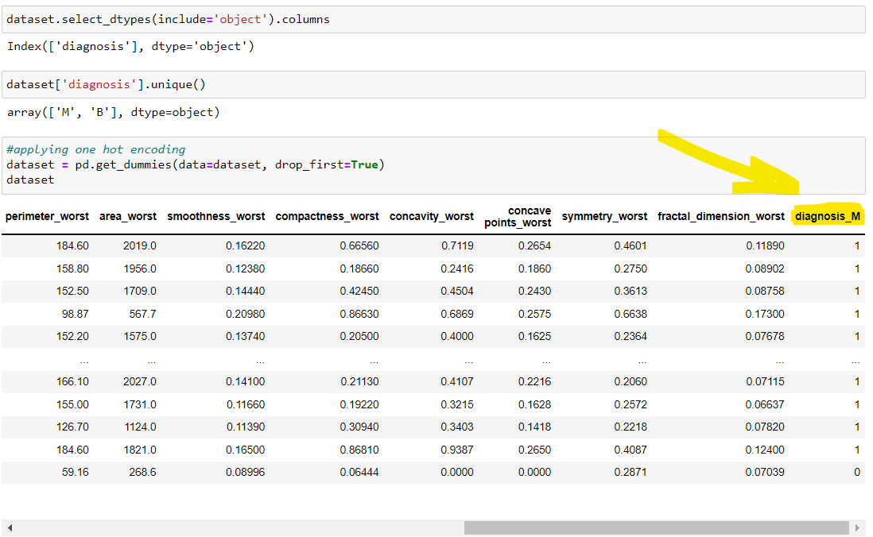
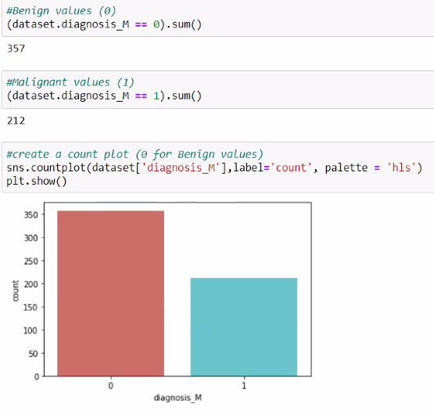
Data Pre-processing - Data visualization
Belinda
We checked the columns containing categorical values (‘object’) -> the result was the ‘diagnosis’ column, which contained two unique values M (Malignant) and B (Benign)
We have applied one hot encoding, converting the categorical values into numerical ones (M=1; B=0)
After we redefined the dataset we counted the malignant and benign diagnosis values.

Slide 9
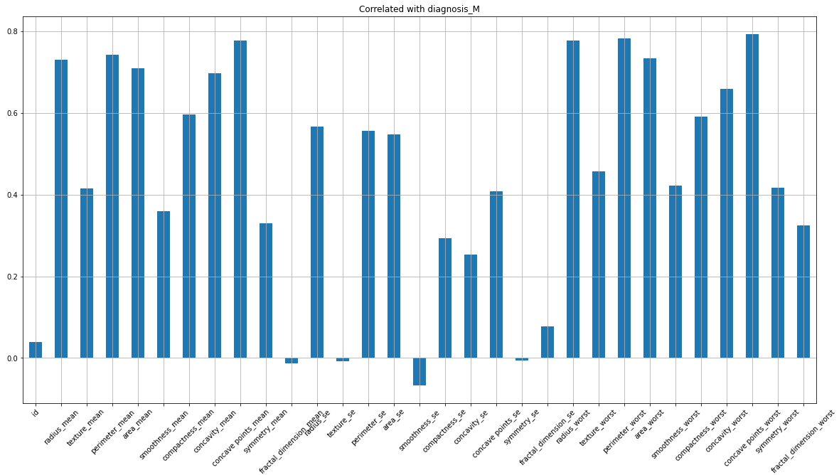
Data Pre-processing - Correlation Matrix
Belinda
To summarize data, we have created a table showing correlation coefficients between independent variables with the dependent variable which is a malignant diagnosis (diagnosis_M).
Each cell in the bar chart below shows the correlation between two variables - the correlation matrix:

Slide 10
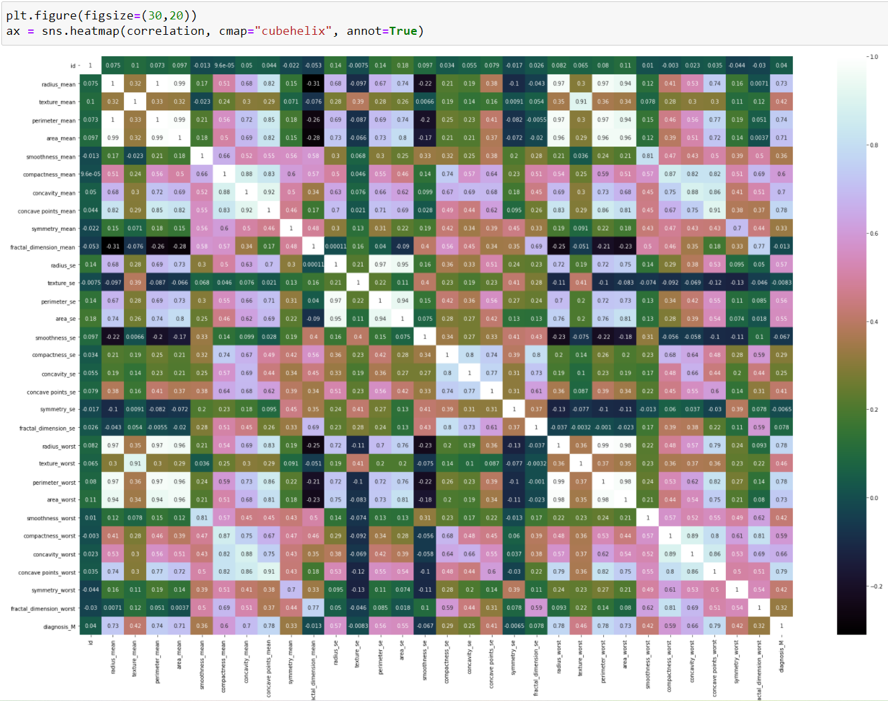
Data Pre-processing
Heatmap
Belinda
To summarize data, we have also created a table showing correlation coefficients between variables each cell in the table showing the correlation between two variables .
As the Correlation Matrix was difficult to read, we have created the following heatmap:

Slide 11
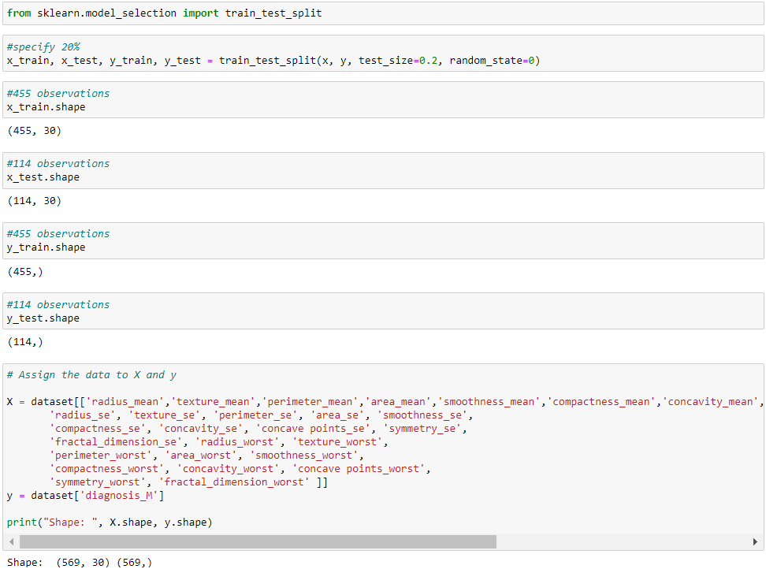
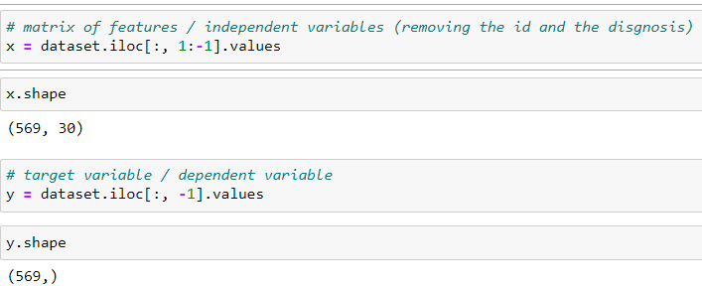
Data Pre-processing - Splitting the dataset train and test set
Mini
We used the train-test split procedure to estimate the performance of machine learning algorithms when they are used to make predictions on data not used to train the model.
There are a total of 569 rows / entries
To split the dataset we will used a class from sklearn library
We used an 80%/20% split, with 455 observation used for training and 114 observations used for testing.

Slide 12
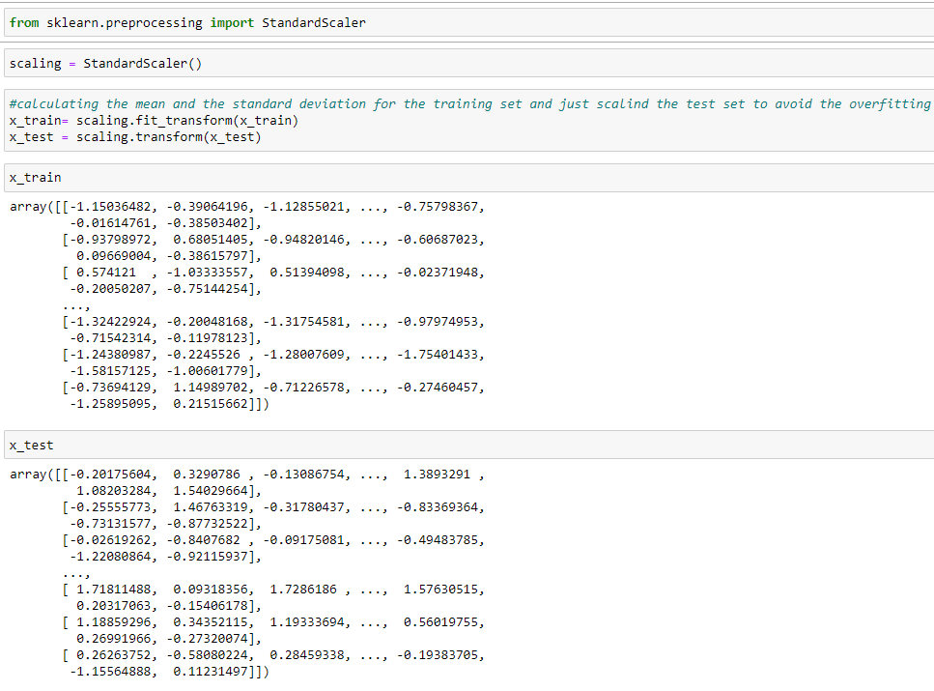
Data Pre-processing - Feature scaling
Mini
As seen before, our data has negative values. As such, we had to standardize the data and arrange it in a standard normal distribution.
Standardization of a dataset is a common requirement for many machine learning estimators: they may behave badly if the individual features do not more or less look like standard normally distributed data
By using the standard scaler we are calculating the mean and the standard deviation for the training set and just scaling the test set to avoid the overfitting.

Slide 13
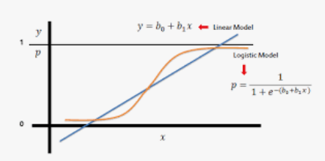
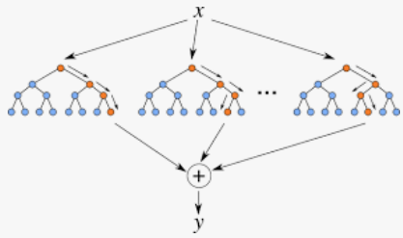
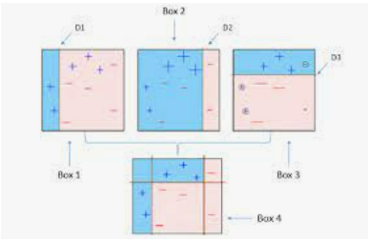
Building the Model
Mini
For this project we have applied three different classification machine learning models:
After analyzing which model performs better we finalized the model.
Logistic Regression
Random Forest
AdaBoost

Slide 14
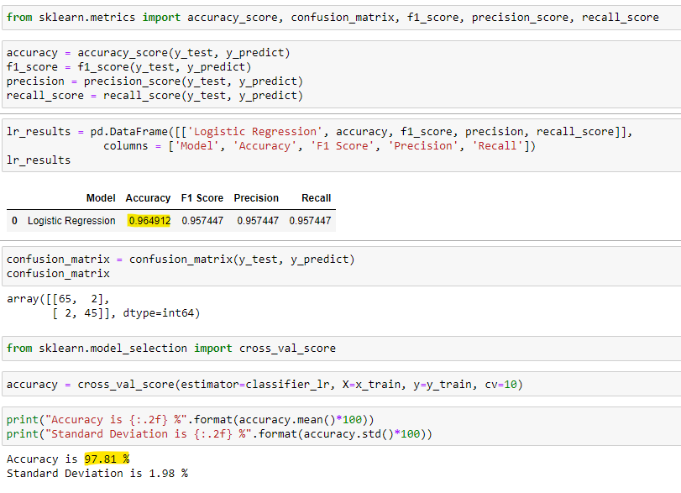
Logistic Regression
Mini
We have imported the LogisticRegression class from sklearn in order to analyze the performance of the logistic regression model
We have imported the following classification metrics:
confusion matrix - to check the number of correct / incorrect predictions
accuracy score - to calculate the accuracy of our model where the set of labels predicted for a sample must exactly match the corresponding set of labels in y_true
F1 score (or F measure) - can be interpreted as a weighted average of the precision and recall, where an f1 score reaches its best value at 1 and worst value at 0
precision score - it reflects the ability of the classifier not to label as positive a sample that is negative; best value is 1 and worst value is 0
recall score - it reflects the ability of the classifier to find all the positive samples; the best value is 1 and the worst value is 0.
We have evaluated the performance of our classification model using the cross validation score. We computed 10 different accuracies on the basis of x_train and y_train, then taken the mean.
By using the cross validation - the accuracy increased from 96.49% to 97.81%

Slide 15
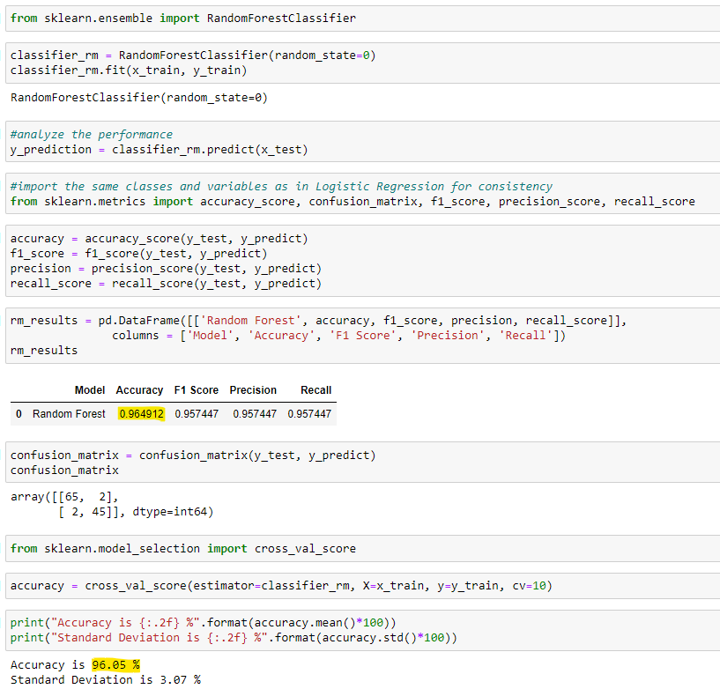
Random Forest
Mini
We have imported the Random forest Classifier from sklearn in order to analyze the performance of the Random Forest model.
We have imported the following classification metrics:
confusion matrix - to check the number of correct / incorrect predictions
accuracy score - to calculate the accuracy of our model where the set of labels predicted for a sample must exactly match the corresponding set of labels in y_true
F1 score (or F measure) - can be interpreted as a weighted average of the precision and recall, where an f1 score reaches its best value at 1 and worst value at 0
precision score - it reflects the ability of the classifier not to label as positive a sample that is negative; best value is 1 and worst value is 0
recall score - it reflects the ability of the classifier to find all the positive samples; the best value is 1 and the worst value is 0.
We have evaluated the performance of our classification model using the cross validation score. We computed 10 different accuracies on the basis of x_train and y_train, then taken the mean.
By using the cross validation - the accuracy decreased from 96.49% to 96.05%, and the standard deviation increased

Slide 16
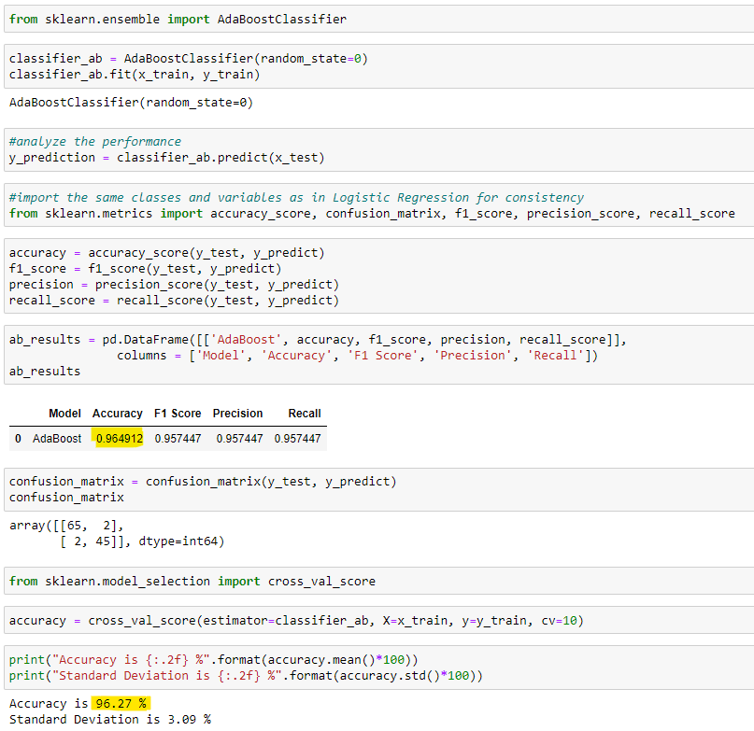
AdaBoost
We have imported the Random forest Classifier from sklearn in order to analyze the performance of the Random Forest model.
We have imported the following classification metrics:
confusion matrix - to check the number of correct / incorrect predictions
accuracy score - to calculate the accuracy of our model where the set of labels predicted for a sample must exactly match the corresponding set of labels in y_true
F1 score (or F measure) - can be interpreted as a weighted average of the precision and recall, where an f1 score reaches its best value at 1 and worst value at 0
precision score - it reflects the ability of the classifier not to label as positive a sample that is negative; best value is 1 and worst value is 0
recall score - it reflects the ability of the classifier to find all the positive samples; the best value is 1 and the worst value is 0.
We have evaluated the performance of our classification model using the cross validation score. We computed 10 different accuracies on the basis of x_train and y_train, then taken the mean.
By using the cross validation - the accuracy decreased from 96.49% to 96.27%, and the standard deviation increased.

Slide 17
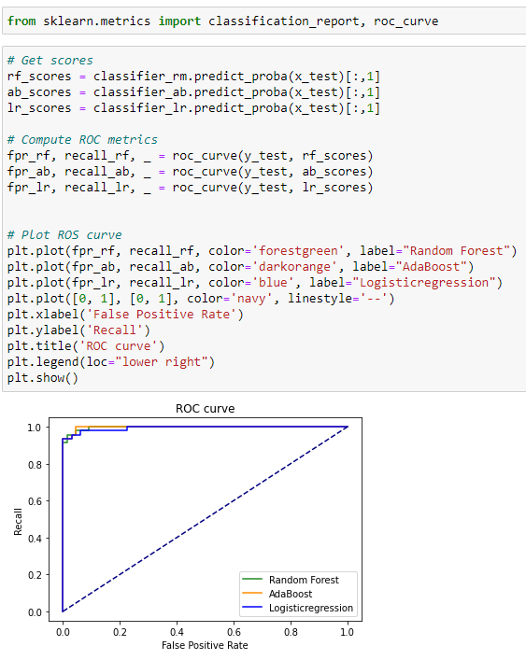
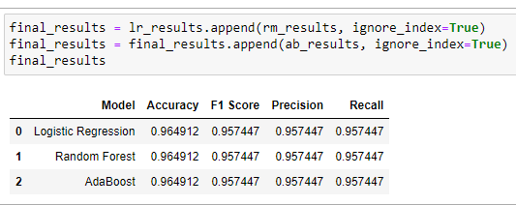
Comparing the models
Ellie
Because all the accuracy scores above are the same, also reflected in the ROC curve, we have compared the cross validation score and chose the model based on the cross validation accuracy:
Logistic Regression: Accuracy=97.81%; Standard Deviation =1.98%
Random Forest: Accuracy=96.05 %; Standard Deviation =3.07
AdaBoost : Accuracy=96.27 %; Standard Deviation =3.09 %

Slide 18
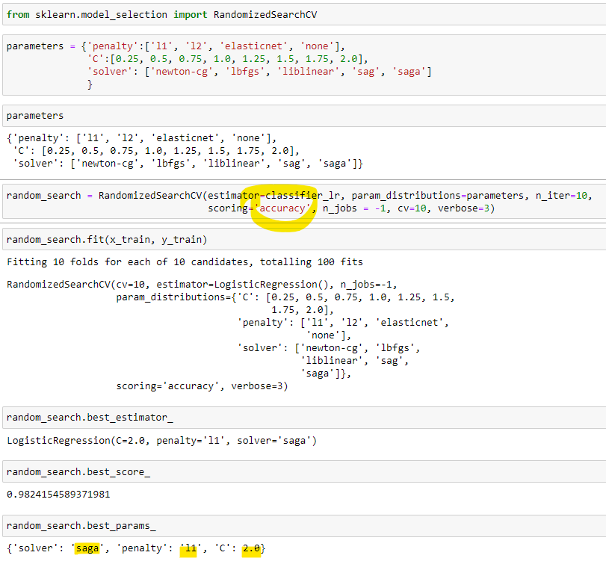
Randomized Search
on Hyper Parameters
Ellie
We decided to use RandomizedSearchCV because, in contrast with GridSearchCV, not all parameter values are tried out, but rather a fixed number of parameter settings is sampled from the specified distribution.
We have used only three parameters:
-Penalty - used to specify the norm used in penalization;
-C - this is the constant which must have a positive value (smaller values specify a stronger regularization)
-Solver - the algorithm used in the optimization problem

Slide 19
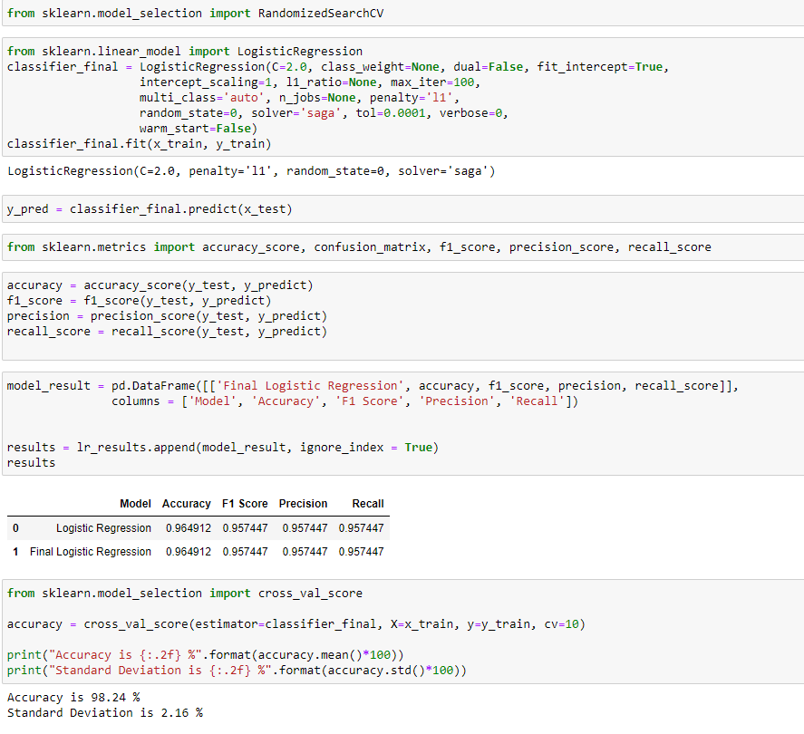
Final Model
Logistic Regression
Ellie
Following the cross validation process, the accuracy increased from 97.81% to 98.24% while the Standard Deviation also increased from 1.98% to 2.16%

Slide 20

Conclusions
Live Test :
Predicting a single random observation
Belinda

Slide 21

Thank you for your attention!
Q & A

